Slide 1
Intentional Code
@LlewellynFalco

Slide 2
Native Tongue
Notes:
Both

Slide 3
Haskell
bottles 0 = "no more bottles"
bottles 1 = "1 bottle"
bottles n = show n ++ " bottles"
verse 0 = "No more bottles of beer on the wall, no more bottles of beer.\n"
++ "Go to the store and buy some more, 99 bottles of beer on the wall."
verse n = bottles n ++ " of beer on the wall, " ++ bottles n ++ " of beer.\n"
++ "Take one down and pass it around, " ++ bottles (n-1)
++ " of beer on the wall.\n"
main = mapM (putStrLn . verse) [99,98..0]
Notes:
Both

Slide 4
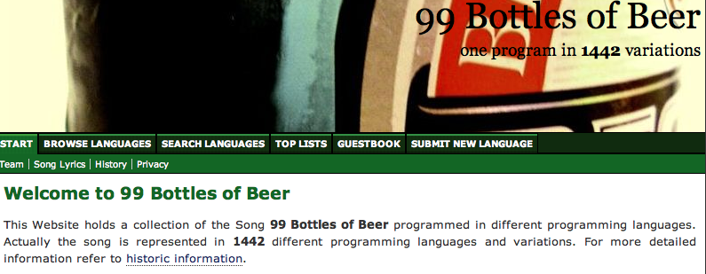
99 Bottles of Beer
Notes:
Both

Slide 5
Ruby
class Integer # The bottles
def drink; self - 1; end
end
class << song = nil
attr_accessor :wall
def bottles
(@bottles.zero? ? "no more" : @bottles).to_s <<
" bottle" << ("s" unless @bottles == 1).to_s
end
def of(bottles)
@bottles = bottles
(class << self; self; end).module_eval do
define_method(:buy) { bottles }
end
self
end
def sing(&step)
puts "#{bottles.capitalize} of beer on the wall, #{bottles} of beer."
if @bottles.zero?
print "Go to the store buy some more, "
step = method :buy
else
print "Take one down and pass it around, "
end
@bottles = step[@bottles]
puts "#{bottles} of beer on the wall."
puts "" or wall.call unless step.kind_of? Method
end
end
callcc { |song.wall| song.of(99) }.sing { |beer| beer.drink }
Notes:
Both

Slide 6
Ruby - Alternative
bottles = lambda {|n| n == 1 ? "#{n} bottle" : "#{n} bottles"}
99.downto 1 do |n|
puts "#{bottles[n]} of beer on the wall
#{bottles[n]} of beer
Take one down, pass it around
#{bottles[n - 1]} of beer on the wall"
end
puts "\n No more beer on the wall :-("
Notes:
Both

Slide 7
Java
(see word document)
Notes:
Both

Slide 8
Java
private void sing(){
for (int i = 99; i >= 1; i--){
System.out.println(singMainVerse(i));
}
System.out.println(singClosingVerse());
}
private String singMainVerse(int n){
return String.format(
"%s of beer on the wall, %s of beer.\n” +
"Take one down and pass it around,” +
” %s of beer on the wall.\n",
bottles(n), bottles(n),
bottles(n- 1));
}
private String bottles(int number) {
switch (number) {
case 0 : return "No bottles";
case 1 : return "1 bottle";
default : return number + " bottles";
}
}
private String singClosingVerse() {
return "No more bottles of beer on the wall,"+
" no more bottles of beer.\n" +
"Go to the store and buy some more,"+
"99 bottles of beer on the wall.\n";
}
Notes:
Both

Slide 9
SmallBasic
Notes:
Both

Slide 10
' Move the turtle 50 pixels
Turtle.Move(50)

Slide 11
Wrap Unintentional Code
Lesson 1:
Notes:
Both

Slide 12
Long != Clear

Slide 13
Recognize Obscured Intention
Lesson 2:
Notes:
Both

Slide 14
Example without intention
Notes:
Both

Slide 15
Mastery

Slide 16
Mastery

Slide 17
4 years old
Notes:
Both

Slide 18
7H15 M3554G3
53RV35 7O PR0V3
H0W 0UR M1ND5 C4N D0
4M4Z1NG 7H1NG5! 1MPR3551V3 7H1NG5!
1N 7H3 B3G1NN1NG 17 WA5 H4RD BU7
N0W, 0N 7H15 LIN3
Y0UR M1ND 1S R34D1NG 17
4U70M471C4LLY W17H 0U7 3V3N
7H1NK1NG 4B0U7 17,
B3 PROUD! 0NLY C3R741N P30PL3 C4N
R3AD 7H15.
U C4N R35D 7H15!!!

Slide 19
Triangle
Notes:
Both

Slide 20
Chapters Titles Paragraph length Sentence length Word choice Punctuation Subtitles Nouns Verbs Adverbs Plot Metaphors Slang/lingo
Method Length Class size Namespaces Level of abstraction
Cyclometric complexity
Line Length
Objects
Methods
Parameters
Interfaces
Inheritance
Domain Specific Language

Slide 21
Resources
Intro To TDD Class (4 Day)
Notes:
Both

Slide 22
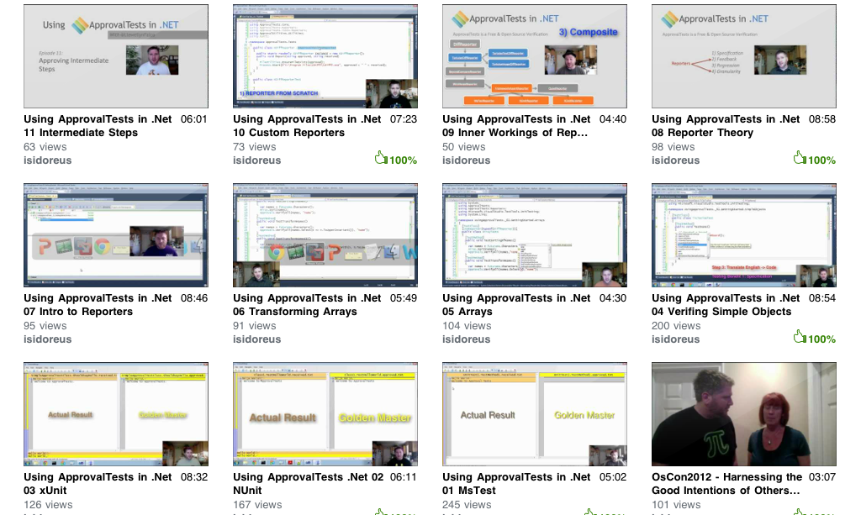
Resources
www.ApprovalTests.com (.net, java, php, ruby)
20 episode youtube series
Notes:
Both

Slide 23
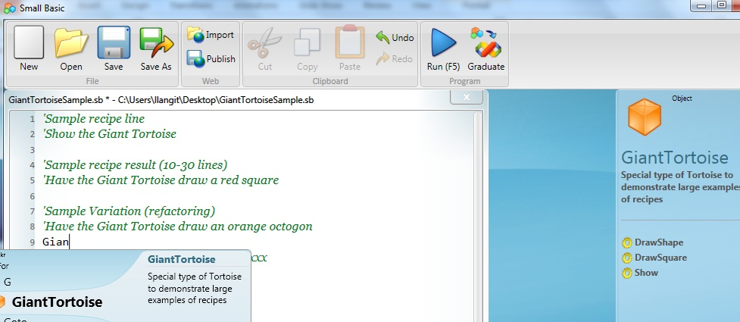
TeachingKidsProgramming.org
Do a Recipe → Teach a Kid (Ages 10 ++)
Microsoft SmallBasic → Free Courseware (recipes)
Notes:
I add this slide at the end of EVERY presentation.

Slide 24

Contact Information
@LlewellynFalco http://LlewellynFalco.Blogspot.com
http://www.approvaltests.com
Notes:
Both

